Slide 1
TO BE FORMS
am,is,are
I am In short - I’m
He is In short- He’s
She is In short- She’s
It is In short- It’s
We are In short -We’re
You are In short -You’re
They are In short -They’re

Slide 2

TO BE FORMS
am,is,are
am, is, are+ number
I am 25 years old.

Slide 3
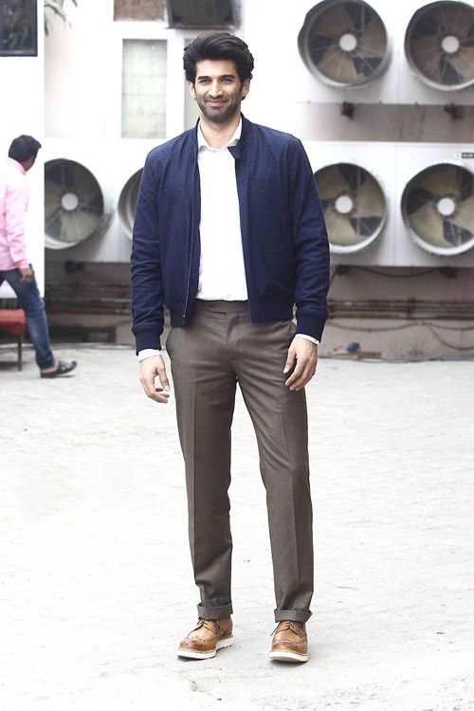
TO BE FORMS
am,is,are
am, is, are+ number
He is 6 feet tall.

Slide 4

TO BE FORMS
am,is,are
am, is, are+ number
It is 8 o’clock.

Slide 5



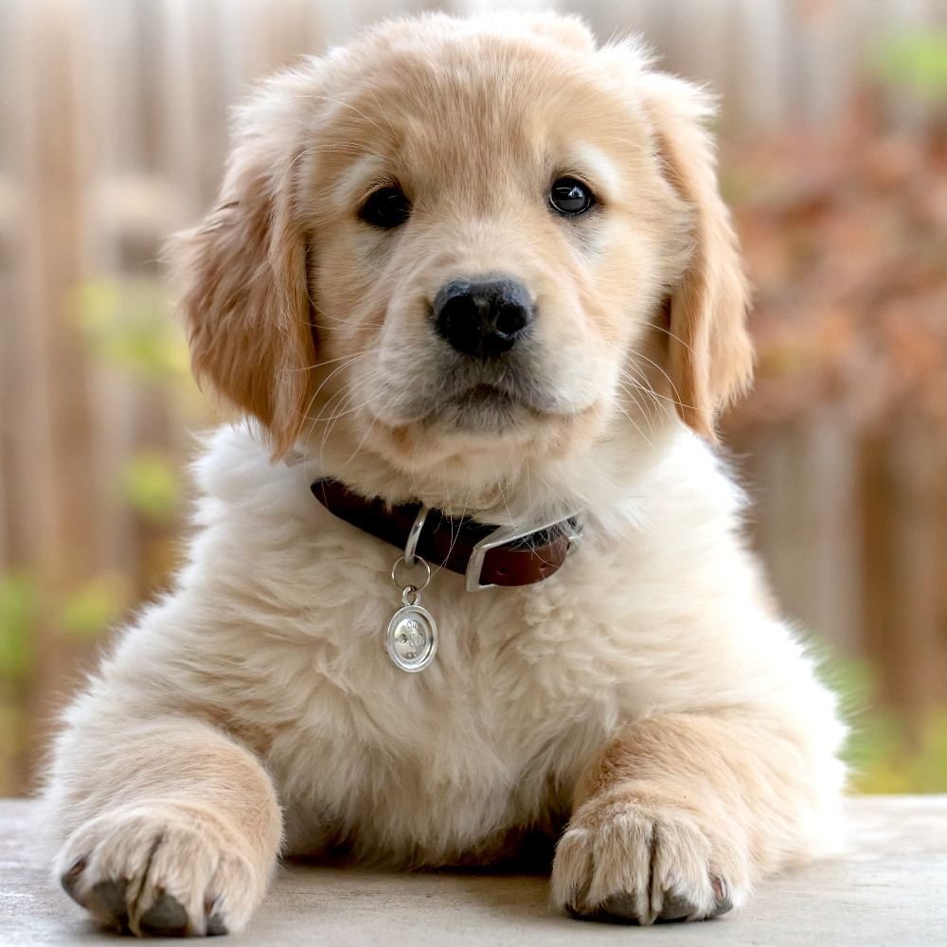

TO BE FORMS
am,is,are
am, is, are+ names
I am a boy.
She is a girl.
We are men.
They are women.
He is Rajesh.
She is Renu.
It is a story book.
It is a dog.

Slide 6



TO BE FORMS
am,is,are
am,is,are+ qualifications
I am a graduate.
You are a graduate.
He is a post-graduate.
They are undergraduates.
She is an M.A in English.

Slide 7



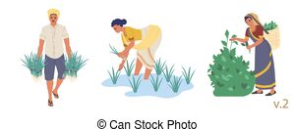
TO BE FORMS
am,is,are
am,is,are+ jobs
I am a doctor.
She is a teacher.
He is an engineer.
They are farmers.

Slide 8
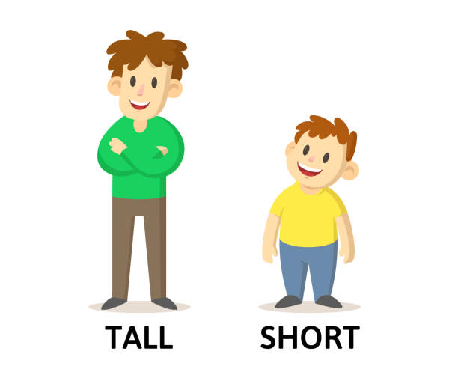


TO BE FORMS
am,is,are
am,is,are+ qualities
I am tall.
My brother is short.
The flowers are beautiful.
The elephant is big.

Slide 9
TO BE FORMS
am,is,are
am,is,are+ qualities
I am tall.
My brother is short.
The flowers are beautiful.
The elephant is big.

Slide 10


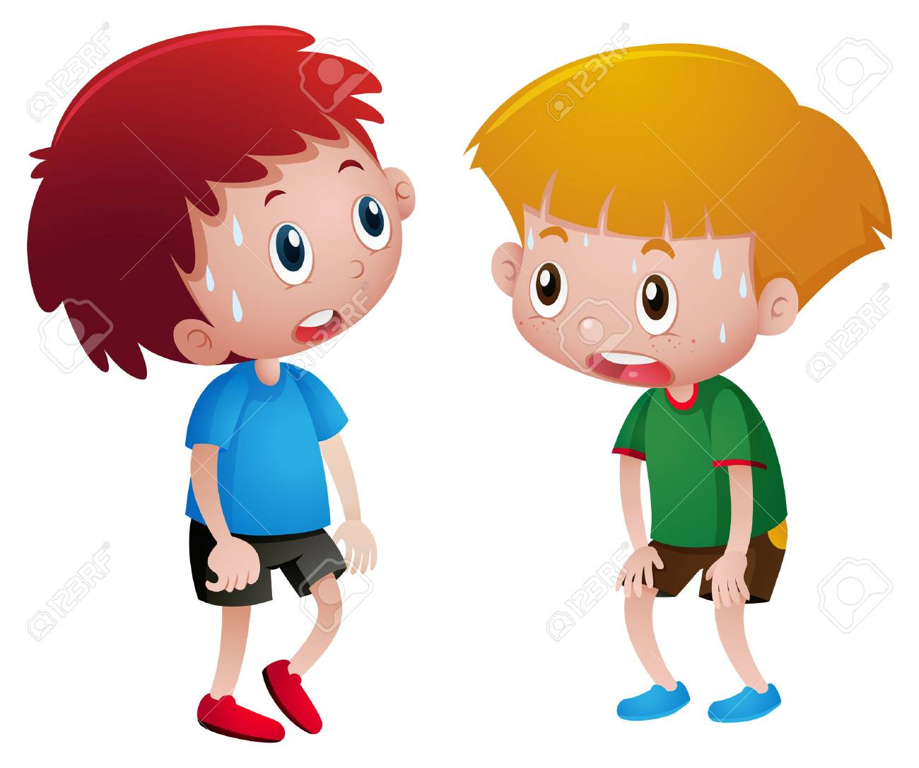

TO BE FORMS
am,is,are
am,is,are+ feelings
I am happy.
She is sad.
We are tired.
They are angry.
.

Slide 11


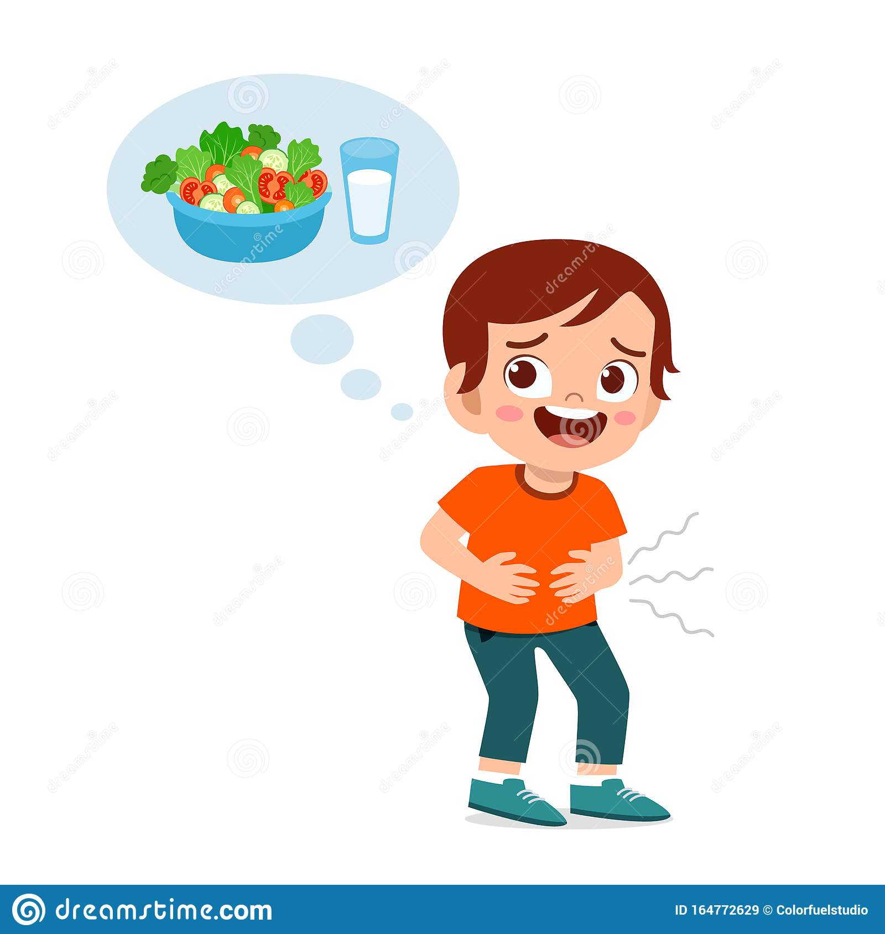


TO BE FORMS
am,is,are
am,is,are+ feelings
The children are excited.
He is thirsty.
He is hungry.
We are proud of our country.
He is bored .

Slide 12
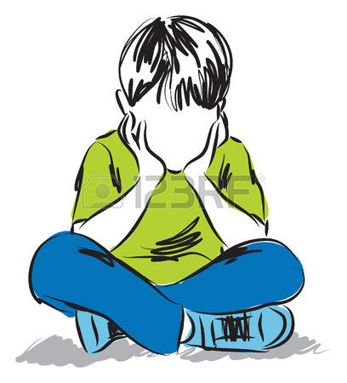




TO BE FORMS
am,is,are
am,is,are+ feelings
I am interested in sports.
She is depressed.
He is disappointed.
We are inspired by Vivekananda.
I am surprised to see you.
He is shocked to hear this. .

Slide 13
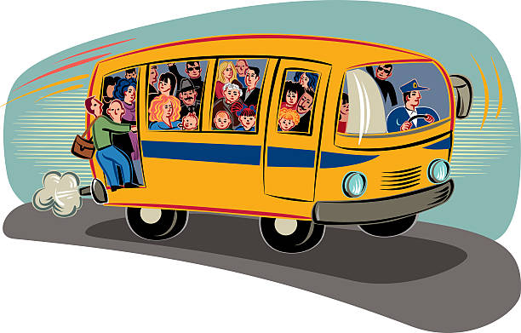



TO BE FORMS
am,is,are
am,is,are + state or condition
I am busy.
The patient is dead.
The students are present.
The bus is crowded.
She is injured.
The insect is alive.
The baby is asleep.
She is awake.
The roads are congested.
She is absent to class.
We are free today.

Slide 14


TO BE FORMS
am,is,are
am,is,are + status
He is married.
They are educated.
She is engaged.
He is divorced.
My father is retired.
He is suspended.
He is dismissed.
They are employed.

Slide 15

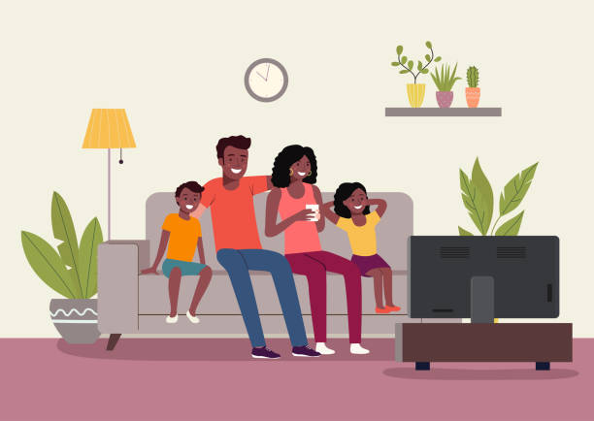
TO BE FORMS
am,is,are
am,is,are + position or location
We are in Delhi.
They are at home.
The books are on the table.

Slide 16




TO BE FORMS
am,is,are
am, is are+ possession and relationship
This is my book.
These pens are mine.
That house is theirs.
This is our car.
This is his bike.
She is his sister.
He is my brother.
They are my parents.
It is our pet dog.

Slide 17

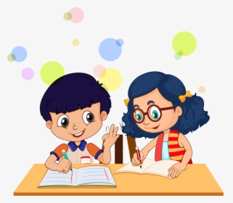


TO BE FORMS
am,is,are
am,is,are +verb+ing
The sun is shining.
It is raining now.
The students are writing.
The children are playing.

Slide 18
TO BE FORMS
am,is,are

Slide 19
TO BE FORMS
am,is,are

